Slide 1



AcF 304 Financial Markets Overview of the Financial System

Slide 2
Topic 1 Preview (1 of 2)
Suppose you want to start a small business whilst at or soon after your time at Lancaster, but you have no funds.
At the same time, a Lancaster private investor has money he wishes to invest for his retirement.
If the two of you could get together, perhaps both of your needs can be met. But how does that happen?

Slide 3
Topic 1 Preview (2 of 2)
As simple as this example is, it highlights the importance of financial markets and financial intermediaries e.g. banks, in our economy.
We need to acquire an understanding of their general structure and operation before we can appreciate their role in our economy.

Slide 4
Flow of Funds Through The Financial System
Direct Finance
Borrowers borrow directly from lenders in financial markets by selling financial instruments (securities) which are claims on the borrower’s future income or assets
Indirect Finance
Borrowers borrow indirectly from lenders via financial intermediaries (established to source both loanable funds and loan opportunities).
Notes:
Securities are assets for the person who buys them , but they are liabilities (IOUs or debts) for the firm or government that sells them.

Slide 5
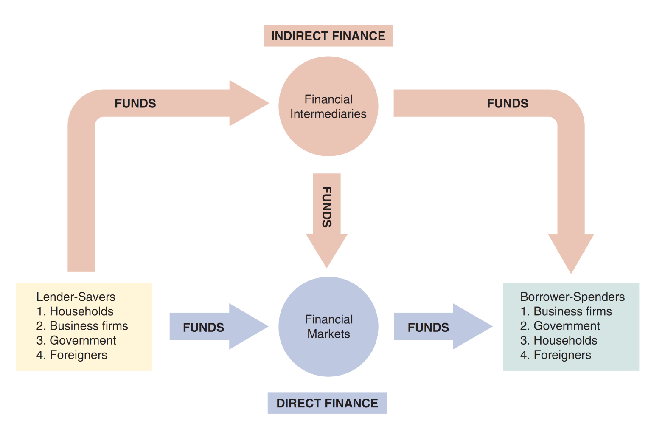
Figure 2.1 Flows of Funds Through the Financial System

Slide 6
Function of Financial Markets
Channels funds from person or business without investment opportunities (i.e., “Lender-Savers”) to one who has them (i.e., “Borrower-Spenders”)
Improves economic efficiency

Slide 7
Financial Markets Funds Transferees
Lender-Savers
Households
Business firms
Government
Foreigners
Borrower-Spenders
Business firms
Government
Households
Foreigners
Notes:
US Budget Deficit $1 Trillion…4.6% of GP
UK Budget Deficit £40Bn..,1,7% of GDP
Surplus -Germany, Netherlands, switzerland, Norway (oil rich)
Apple has $245Billion cashpile
Amazon close to $50 Billion
All companies will have a certain amount of funds in cash to be lent out to make sure they have short term financing available even if they are not a particularly cash rich institution.
Saudi sovereign wealth funds in the world with total estimated assets of $320 billion
House of Saudi (Royal Family is estimated to be worth $1.4 trillion)

Slide 8
Importance of Financial Markets (1 of 2)
This is important. For example, if you save $1,000, but there are no financial markets, then you can earn no return on this - might as well put the money under your mattress.
However, if, for example, a carpenter could use that money to buy a new saw (increasing his/her productivity), then he/she is willing to pay you some interest for the use of the funds.

Slide 9
Importance of Financial Markets (2 of 2)
Financial markets are critical for producing an efficient allocation of capital, allowing funds to move from people who lack productive investment opportunities to people who have them.
Financial markets also improve the well-being of consumers, allowing them to time their purchases better e.g. a 30-year mortgage, a credit card payment.
Notes:
Consumers time purchases e,g.
2019 -91% of new private cars were purchased by finance or a lease basis i.e. consumers borrowed to pay for purchase

Slide 10
Structure of Financial Markets (1 of 6)
It helps to define financial markets along a variety of dimensions (not necessarily mutually exclusive). For starters…

Slide 11
Structure of Financial Markets (2 of 6)
Debt Markets
Short-Term (maturity < 1 year)
Long-Term (maturity > 10 year)
Intermediate term (maturity in-between)
Represents a loan to the company/government
Bond/loan has an interest payment associated
$39.7 trillion bonds outstanding today (US).
Equity Markets
Pay dividends, in theory forever
Represents an ownership claim in the firm
Total value of all U.S. equity is just over $30 trillion today.
Notes:
If a company has issued 1 million share and you own 1 share , you are entitled to 1 millionth of the firm’s net income and 1 millionth of the firm’s assets
Disadvantage of equities=Residual Claimant –the corporation must pay all its debt holders before it pays its equity holders
Advantage=share holders benefit from an increase in the profitability of the company

Slide 12
Structure of Financial Markets (3 of 6)
Primary Market
New security issues sold to initial buyers
Typically involves an investment bank who underwrites the offering
Secondary Market
Securities previously issued are bought and sold
Examples include the NYSE and NASDAQ, TRADEWEB
Involves both brokers and market-makers (do you know the difference?)

Slide 13
Structure of Financial Markets (4 of 6)
Even though firms don’t get any money, per se, from the secondary market, it serves important functions:
Provides liquidity, making it easy to buy and sell the securities of the companies
Establishes a price for the securities (useful for company valuation)
Provides useful security financial information
Provides useful customer information
An investment bank will not win a lucrative Primary market mandate e.g.US equity IPO unless it has a strong Secondary market presence

Slide 14
Structure of Financial Markets (5 of 6)
We can further classify secondary markets as follows:
Exchanges
Trades conducted in central locations (e.g., New York Stock Exchange, CBOT)
Over-the-Counter Markets
Dealers at different locations buy and sell
Best example is the market for US Treasury Securities
Others e.g. German Govt Bonds, Foreign Exchange

Slide 15
Structure of Financial Markets (6 of 6)
We can also classify markets by the maturity of the securities:
Money Market: Short-Term (maturity < 1 year)
Capital Market: Intermediate & Long-Term Debt
Intermediate maturity 1 - 10 years
Long-term > 10 years
Plus equities (no maturity)

Slide 16
Internationalisation of Financial Markets (1 of 2)
The internationalisation of markets is an important trend. The U.S. no longer dominates the world stage.
International Bond Market & Eurobonds
Foreign bonds
Sold in a foreign country
Denominated in a that country’s currency eg.New Zealand issuing a GBP bond in UK regulated domestic bond market
Eurobonds (Much bigger!)
Denominated in a currency other than that of the country in which it is sold e.g. Walt Disney $ bond in Europe, Nissan Yen bond in Europe, Coca Cola $ bond in Europe
$ Eurobond market now larger than U.S. corporate bond market
Over 80% of new bonds are Eurobonds

Slide 17
Internationalisation of Financial Markets (2 of 2)
Eurocurrency Market (FX not bonds!)
Foreign currency deposited outside of home country
Eurodollars are U.S. dollars deposited, say, London.
Gives U.S. borrowers an alternative source for dollars.
World Stock Markets
U.S. stock markets are no longer always the largest -at one point, Japan’s was larger
Note: These terms are nothing to do with the EUR/Euro

Slide 18
Function of Financial Intermediaries: Indirect Finance (1 of 9)
Instead of savers lending/investing directly with borrowers, a financial intermediary (such as a bank) plays as the middleman:
the intermediary obtains funds from savers
the intermediary then makes loans/investments with borrowers
e.g. a bank might launch a new savings account for investors that households may invest it. The bank then uses those deposits to make a loan to General Motors or a loan to the US Government by buying a US Treasury Bond.

Slide 19
Function of Financial Intermediaries: Indirect Finance (2 of 9)
This process, called financial intermediation, is actually the primary mean of moving funds from lenders to borrowers.
Needed because of transactions costs, risk sharing, and asymmetric information
More important source of finance than securities markets (such as stocks i.e Direct Finance!)

Slide 20
Global: The Importance of Financial Intermediaries Relative to Securities Markets
Studies show that firms in the U.S., Canada, the U.K., and other developed nations usually obtain funds from financial intermediaries, not directly from capital markets.
In Germany and Japan, financing from financial intermediaries exceeds capital market financing 10-fold.
However (re direct finance) - the relative use of bonds versus equity does differ by country.
Notes:
When businesses go looking for funds, they (inc US) usually go the indirect finance route rathe than issue securities.Germany & Japan have made least use of securities.Indirect finance x10 bigger than direct finance.
DIRECT FINANCE: What about relative importance of stock v bond markets.
In US bonds far more important source of direct finance (x 10 versus stocks).
France and Italy make more us eof equities than bonds.

Slide 21
Function of Financial Intermediaries: Indirect Finance (3 of 9)
Needed because of transactions costs, risk sharing, and asymmetric information
Transactions Costs
Financial intermediaries make profits by reducing transactions costs
Reduce transactions costs by developing expertise and taking advantage of economies of scale

Slide 22
Function of Financial Intermediaries: Indirect Finance (4 of 9)
A financial intermediary’s low transaction costs mean that it can provide its customers with liquidity services, services that make it easier for customers to conduct transactions
Banks provide depositors with bank accounts that enable them to pay their bills easily
Depositors can earn interest on bank and savings accounts and yet still convert them into goods and services whenever necessary

Slide 23
Function of Financial Intermediaries: Indirect Finance (5 of 9)
Another benefit made possible by the FI’s low transaction costs is that they can help reduce the exposure of investors to risk, through a process known as risk sharing
FIs create and sell assets with lesser risk to one party in order to buy assets with greater risk from another party
This process is referred to as asset transformation, because in a sense risky assets are turned into safer assets for investors e.g. asset-backed securities

Slide 24
Function of Financial Intermediaries: Indirect Finance (6 of 9)
Financial intermediaries also help by providing the means for individuals and businesses to diversify their asset holdings.
Low transaction costs allow them to buy a range of assets, pool them, and then sell rights to the diversified pool to individuals e.g. a private investor invests $20,000 in a US equity investment fund

Slide 25
Function of Financial Intermediaries: Indirect Finance (7 of 9)
Another reason FIs exist is to reduce the impact of asymmetric information.
One party lacks crucial information about another party, impacting decision-making.
We usually discuss this problem along two fronts: adverse selection and moral hazard.
Notes:
E.G. a borrower who takes out a loan usually has better information about the potential returns and risk associated
with the investment process than the lender does.

Slide 26
Function of Financial Intermediaries: Indirect Finance (8 of 9)
Asymmetric Information: Adverse Selection and Moral Hazard
Adverse Selection
Before transaction occurs
Potential borrowers most likely to produce adverse outcome are ones most likely to seek a loan..
Similar problems occur with insurance where unhealthy people want their known medical problems covered
Notes:
It is the reckless relative not the conservatibe one that is most likely to seek a loan
i.e.borrowers seeking loans are more likely to be bad credit risks
If you did not know the borrower well you are likely to lend to none of them because you can’t differentiate good credit risks from bad

Slide 27
Function of Financial Intermediaries: Indirect Finance (9 of 9)
Asymmetric Information: Adverse Selection and Moral Hazard
Moral Hazard
After transaction occurs
Hazard that borrower has incentives to engage in undesirable (immoral) activities making it more likely that won’t pay loan back..
Again, with insurance, people may engage in risky activities only after being insured
Financial intermediaries reduce adverse selection and moral hazard problems, enabling them to make profits.
Notes:
i.e. you going going ski-ing with your bad knee because you have now have medical insurance in place but may not go without that insurance
Or now you have your $10,000 loan you might decide to play the stock market rather than build the house extension.
The lender can’t easily control what you are going to do with the money.
So the problems created by adverse selection and moral hazard are significant impediments to well-functioning financial markets

Slide 28
Reading
Financial Markets and Institutions (FM & I)
Frederic Mishkin & Stanley Eakins
Ninth Edition
Chapter 2
Overview of the Financial System

